Slide 1

Targeted Strategies in Reducing the Spread of COVID-19
Effectiveness of policies on data-driven subgroups
Jonathan Tsao

Slide 2

Project motivation
The COVID-19 pandemic has significantly affected all of us.
The effectiveness of state-mandated interventions (e.g. masks, stay at home, travel restrictions) are still debated
There is vast heterogeneity among US states both in population and COVID-19 policies
We need a more targeted approach that would address specific needs of each community.

Slide 3




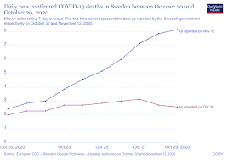

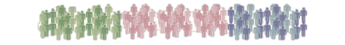
Addressing the problem
Identify subgroups based on community-level characteristics that would predict effectiveness of COVID-19 policies

Slide 4
STEP 1: IDENTIFY SUBGROUPS Use multivariate approaches (e.g. cluster analysis) to identify subgroups of communities using relevant characteristics (e.g. population density, income, age)

Slide 5
STEP 2: EVALUATE EFFECTIVENESS
Use identified subgroups to evaluate effectiveness of COVID-19 policies (e.g. mask mandate, stay at home, and business closure order) using positivity rate as a measure of COVID-19 spread

Slide 6
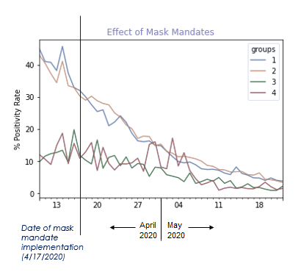
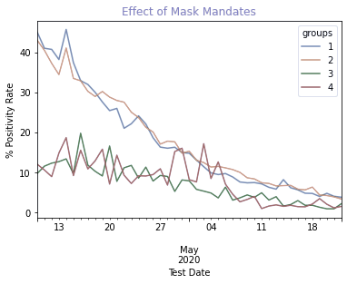

Effectiveness of mask mandate in NY state
Preliminary analysis based on one state (NY) and using only two community characteristics.
Subgroups created using county-level population density and poverty rate:
Group 1: High pop. density, high poverty
Group 2: High pop. density, low poverty
Group 3: Low pop. density, high poverty
Group 4: Low pop. density, low poverty
Date of mask mandate implementation
(4/17/2020)
https://github.com/bluejkrew/TDI_Capstone

Slide 7

Current databases
New York State Statewide COVID-19 Testing:
https://health.data.ny.gov/Health/New-York-State-Statewide-COVID-19-Testing/xdss-u53e
Population Estimates (for Population Density): https://data.ny.gov/Government-Finance/Annual-Population-Estimates-for-New-York-State-and/krt9-ym2k
Land Area (for Population Density): https://www.health.ny.gov/statistics/vital_statistics/2010/table02.htm
Age and Poverty Rate Demographics:
- Datausa.io
- U.S. Census Tract Data
COVID-19 US State Policy Database:
https://www.openicpsr.org/openicpsr/project/119446/version/V44/view
*These are all publicly available databases.

Slide 8
Who will benefit from this project? (Who are my end users?)
Policymakers
Public health officials
General public
Rapid identification of most appropriate policies for their communities
Accelerate policy decision making
Save more lives
Predictive algorithm for end users

Slide 9
Project outline
Week 1-2: Extensive data collection of samples and features (county-level community characteristics for additional US states; effectiveness of multiple policies: mask, stay at home, business closure)
Week 3-4: Examine and prepare data for analysis
Plot time-series (pre/post policy) & data visualization
Week 5-6: Create subgroups using clustering, including k-means; conduct dimensionality reduction
Week 7-8: Conduct predictive analysis of policy effectiveness; finalize predictive algorithm.
Outline created to align with Data Incubator Data Science Essentials curriculum

Slide 10
THANK YOU !

